Slide 1
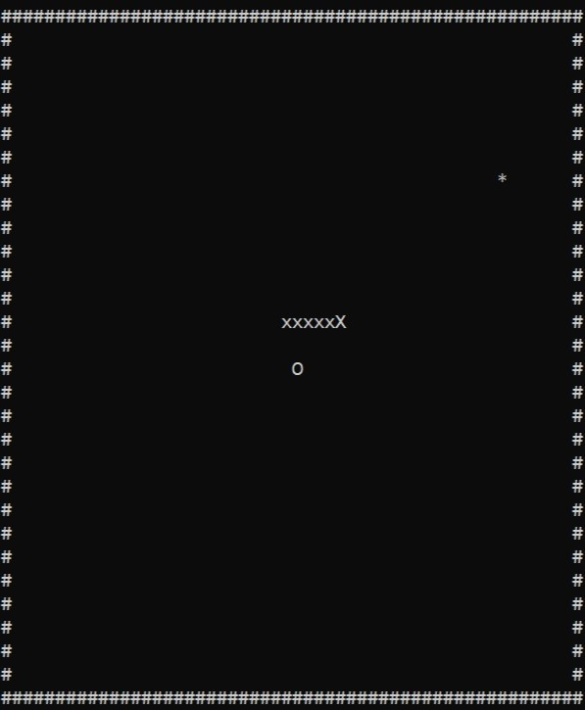
Multi-Player Snake Game
Hafiz Hamza(Gl) (032),Daniyal Jamil(024),Abdul Moiz (002),Aymal Ahmad (022)

Slide 2
Introduction:
This project introduces a multiplayer snake game in C++ with a console interface, allowing two players to control separate snakes in a shared grid.
Motivated by showcasing programming skills and exploring multiplayer game development in a console environment, This project uses Only Basic C++ Libraries such as <iostream>, <conio.h>, <string> etc.
Basically, the main point of this whole project is creating a c++ multiplayer snake game while using only concepts taught at the university.
As such, we’ve fully utilized many loops, functions and function calls, basic file handling and user input etc. throughout the project.
Fun fact:
The gaming industry earns more than film industry and music industry combined. In 2021 alone making $180BN leaving Hollywood far behind in annual revenue, which makes gaming a big industry full of opportunities.

Slide 3
Problem Statements
In initial phases, continuous flickering was faced.
Snake movement was difficult to understand and implement.
Implementing multiplayer into the snake game was difficult.
Figuring out the movement of the second snake was hard.
Implementation of data base was extremely challenging.
File handling without F stream library was hard to handle.

Slide 4

Motivation behind the project:
The project's motivation stemmed from creating an engaging and interactive game to showcase programming skills while exploring the implementation of a multiplayer gaming experience within a console environment.
-------------------------------------------------------------------------------------------------------------------------------------------------------------------------
Throughout time, many snake games have been created, such as the iconic Nokia 3310 snake game, but never has a good multiplayer snake game been created within a console environment.
That is where we got our motivation, our goal was to create the game with only simple c++ libraries and thing we've learned at the university, but with a new challenge of making it multiplayer while implementing innovative ideas, such as a text file-based score data base.
-------------------------------------------------------------------------------------------------------------------------------------------------------------------------
Console-based games, though seemingly simple, provide fundamental insights into game development logic and user input handling. Hence, This game could also serve as a fun learning experience for programmers struggling to grab the basics of nested loops, how functions work, file handling etc.

Slide 5
What makes it unique?
Features
Controls And Input
Console based
Strictly followed the scope
No gaming libraries
Multiple input simultaneously
Smooth gameplay
Player 1:
W = Up.
A = Left.
S = Down.
D = Right.
Player 2:
Arrow Up = Up.
Arrow left = Left.
Arrow Down = Down.
Arrow right = Right.

Slide 6
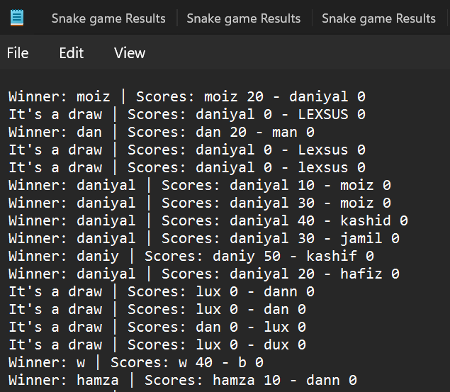
Data Base design
The database for this game is very simple and easy to understand.
As the game ends, the function “save Results();” is called and it saves the results of winner and loser along with their names and scores.
To avoid overwriting, the functions of “<stream>” library is used.
once the file is filled, you can easily replace a new database by putting new file name with “.txt” extension.

Slide 7
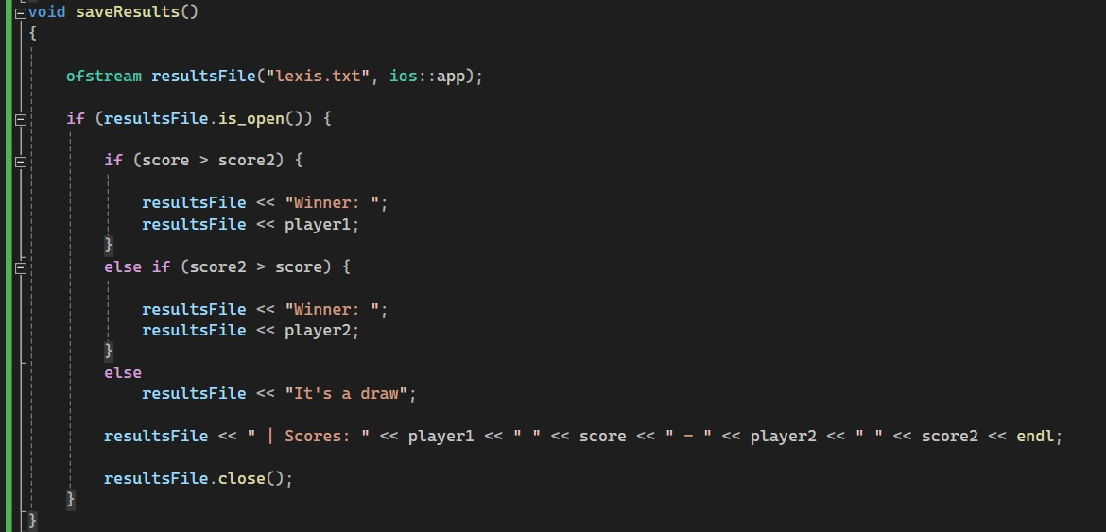
Database libraries and functions
Library and built in functions
Use of library Functions
The library <fstream> is used to make
database in code. The of stream function
inputs data in database without deleting
previous data making it well organized.
In this way a leaderboard of sorts is formed. Storing wins and losses every time the game finishes.
Custom player names are also stored in the text file that is created at the end.

Slide 8
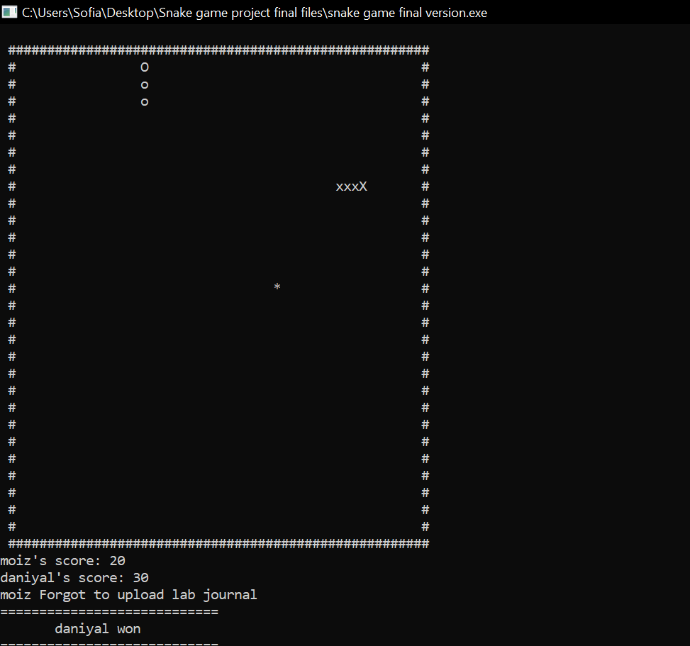
Objectives
Implement a multiplayer snake game with independent control for two players.
Develop logic for snake movement, collision detection, and scoring. Create an interactive and visually appealing console interface.
Ensure synchronized input for a seamless two-player gaming experience.
Implement the File handling lectures taught in class and create a simple leaderboard/Database.
Store all scores after game ends in a text file, hence, creating a data base.
ONLY use c++ basic libraries without using any external libraries such as raylib.io ( without using any object oriented programming).

Slide 9
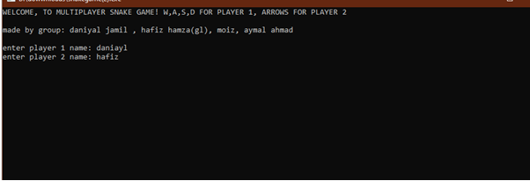
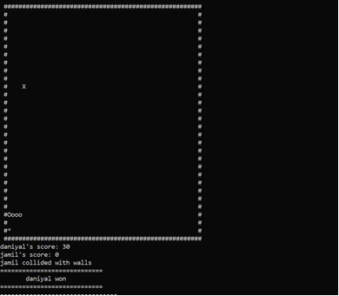
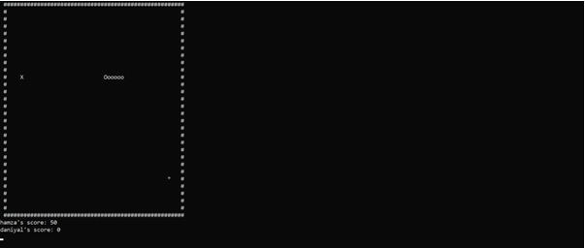
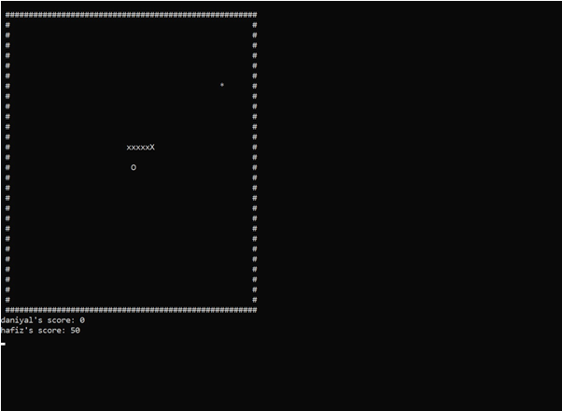
Results
Utilizes C++ concepts such as arrays, randomization, and conditional statements.
Captures user input using _kbhit() and GetAsyncKeyState() for Player 1 and Player 2.
Game logic updates snake positions, tail arrays, checks collisions, and manages scoring.

Slide 10

Conclusion
Concluding our presentation, This project has faced a lot of problems but we overcame them and found a innovative result in the form of a Multiplayer Snake game with data base implementations.
At the end of a project we developed a fully working CONSOLE based multiplayer snake game.

